Slide 1

Smart Lecturer Availability System
By: NorthDevs

Slide 2

Teams And Roles
Team: North Devs
Project Manager: Mabapa Mpho
System Architect: Teboho Lebenya
Developer : Matsie Bopape
Software Engineer : Marumo Matome

Slide 3

Introduction
Smart Lecturer Scheduling, Availability & Navigation System is a web app developed to simplify booking appointments with lecturers, tracking their availability, and navigating to their offices within the university. It is built to enhance convenience and efficiency for students in the Faculty of Natural Science, Mathematical And Computing Sciences department at Walter Sisulu University.

Slide 4
Problem
Manual scheduling of appointments is tedious
Students struggle to find available time slots with lecturers
No centralized platform for appointment management
Navigation between offices is often unclear
Booking conflicts and lack of reminders cause missed appointments

Slide 5
Solution
A centralized, smart system that allows:
Real-time availability tracking
Students to book and cancel appointments via a mobile interface
Prevention of double bookings
Navigation support to guide students to lecturer offices
Improved coordination and communication

Slide 6
Key Features
📅 Real-time booking and schedule management
🔄 Dynamic slot availability (prevents double-booking)
🧭 In-app navigation to faculty offices
❌ Booking cancellation and history tracking
🔔 Notification and reminder system
👤 User roles: student, lecturer, and admin interfaces

Slide 7

Technology Stack
Frontend: Flutter (Dart)
Backend: Firebase
Database: Firestore (Realtime Database)
Authentication: Firebase Auth
Platform: Android (with potential iOS support)
Third-party APIs: Google Maps API for navigation

Slide 8

Phase 1

Slide 9
Product Vision
Key Features
Real-time availability checking: Students can see when staff are available for appointments.
Appointment scheduling and cancellation: Easy to book or cancel appointments with just a few clicks.
Notifications and reminders: Automated notifications and reminders for both students and staff about upcoming appointments.
Staff location and navigation: A map that helps students navigate to staff offices or meeting locations within the university.
Success Metrics
Reduced waiting times for students: Faster access to appointments.
Improved staff availability management: Fewer missed appointments and better time allocation for staff.
Increased user satisfaction: Positive feedback from both students and staff about ease of use and convenience.
Problem Statement
Students have trouble scheduling appointments with university staff, which wastes time and causes confusion. Staff also find it difficult to manage their schedules, leading to missed appointments. First-year students often struggle to find their lecturers' offices, making it harder for them to meet with staff.
Target Users
University students and University staff (lecturers and advisors)

Slide 10
Moore’s Vision Statement
For university students and staff Who struggle with inefficient appointment management, The Smart Lecturer Availability & Navigation System Is a web-based platform for seamless appointment booking and navigation, That allows students to view available slots, schedule appointments, and navigate to staff locations, Unlike traditional manual scheduling or outdated systems, Our Product provides a convenient, time-saving, and reliable solution with live availability updates.

Slide 11
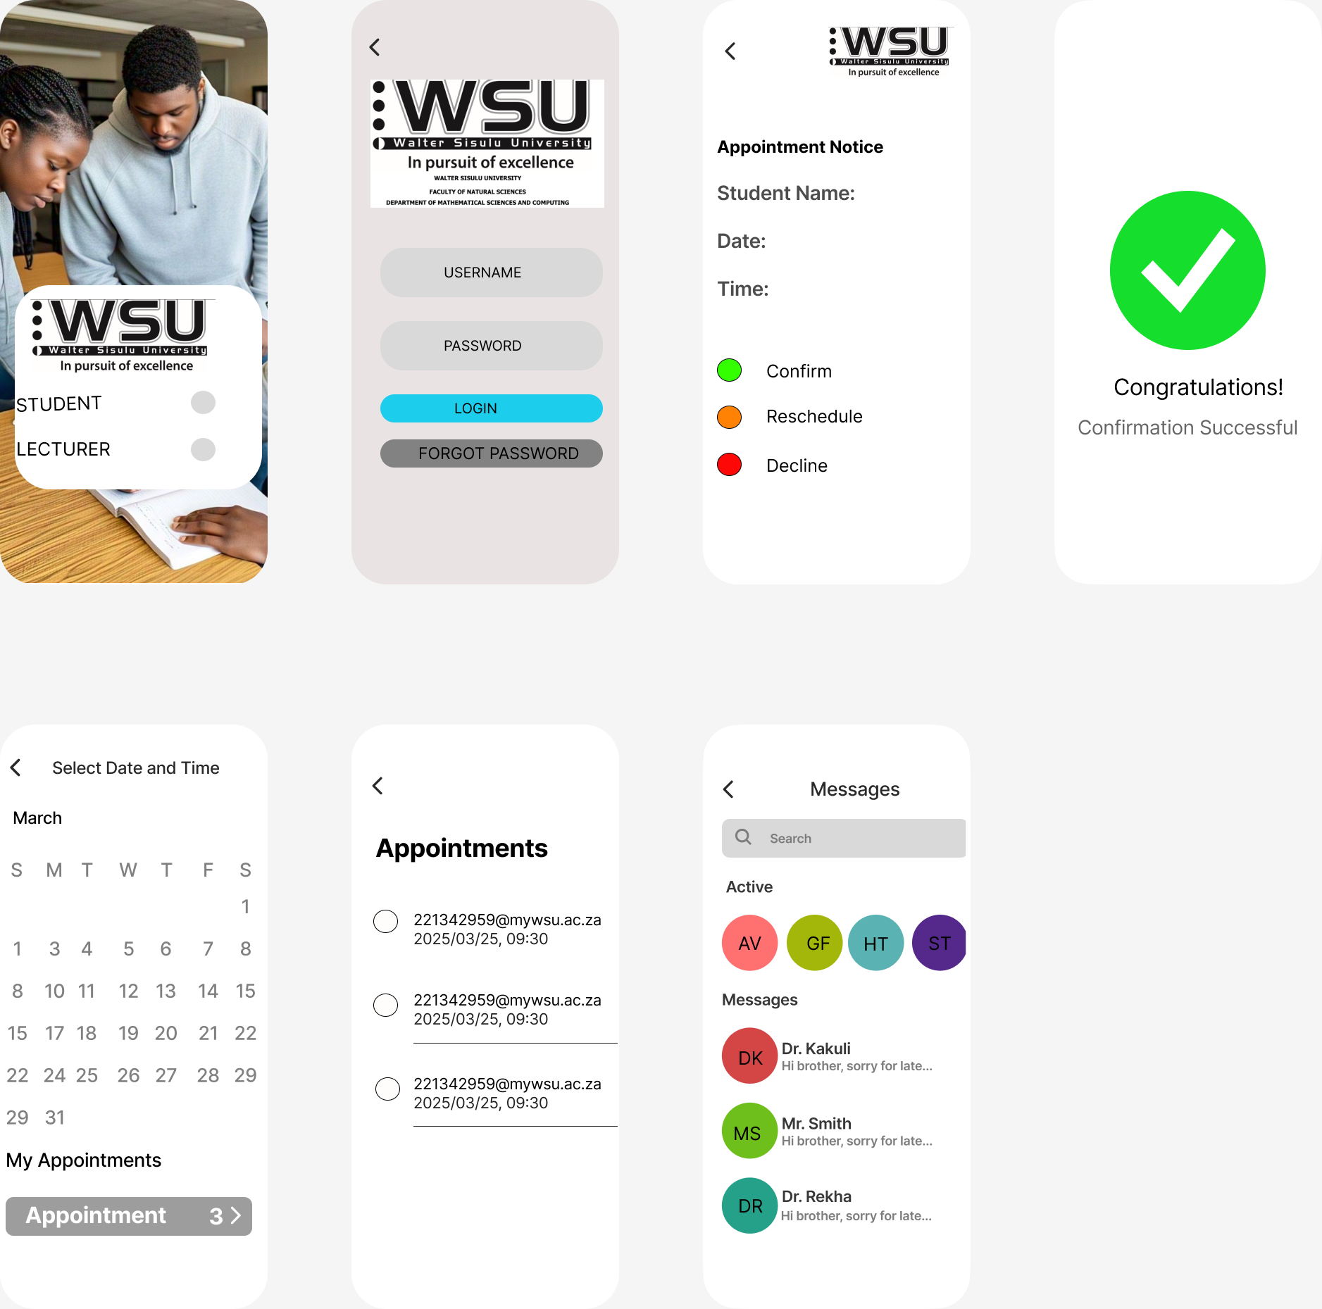
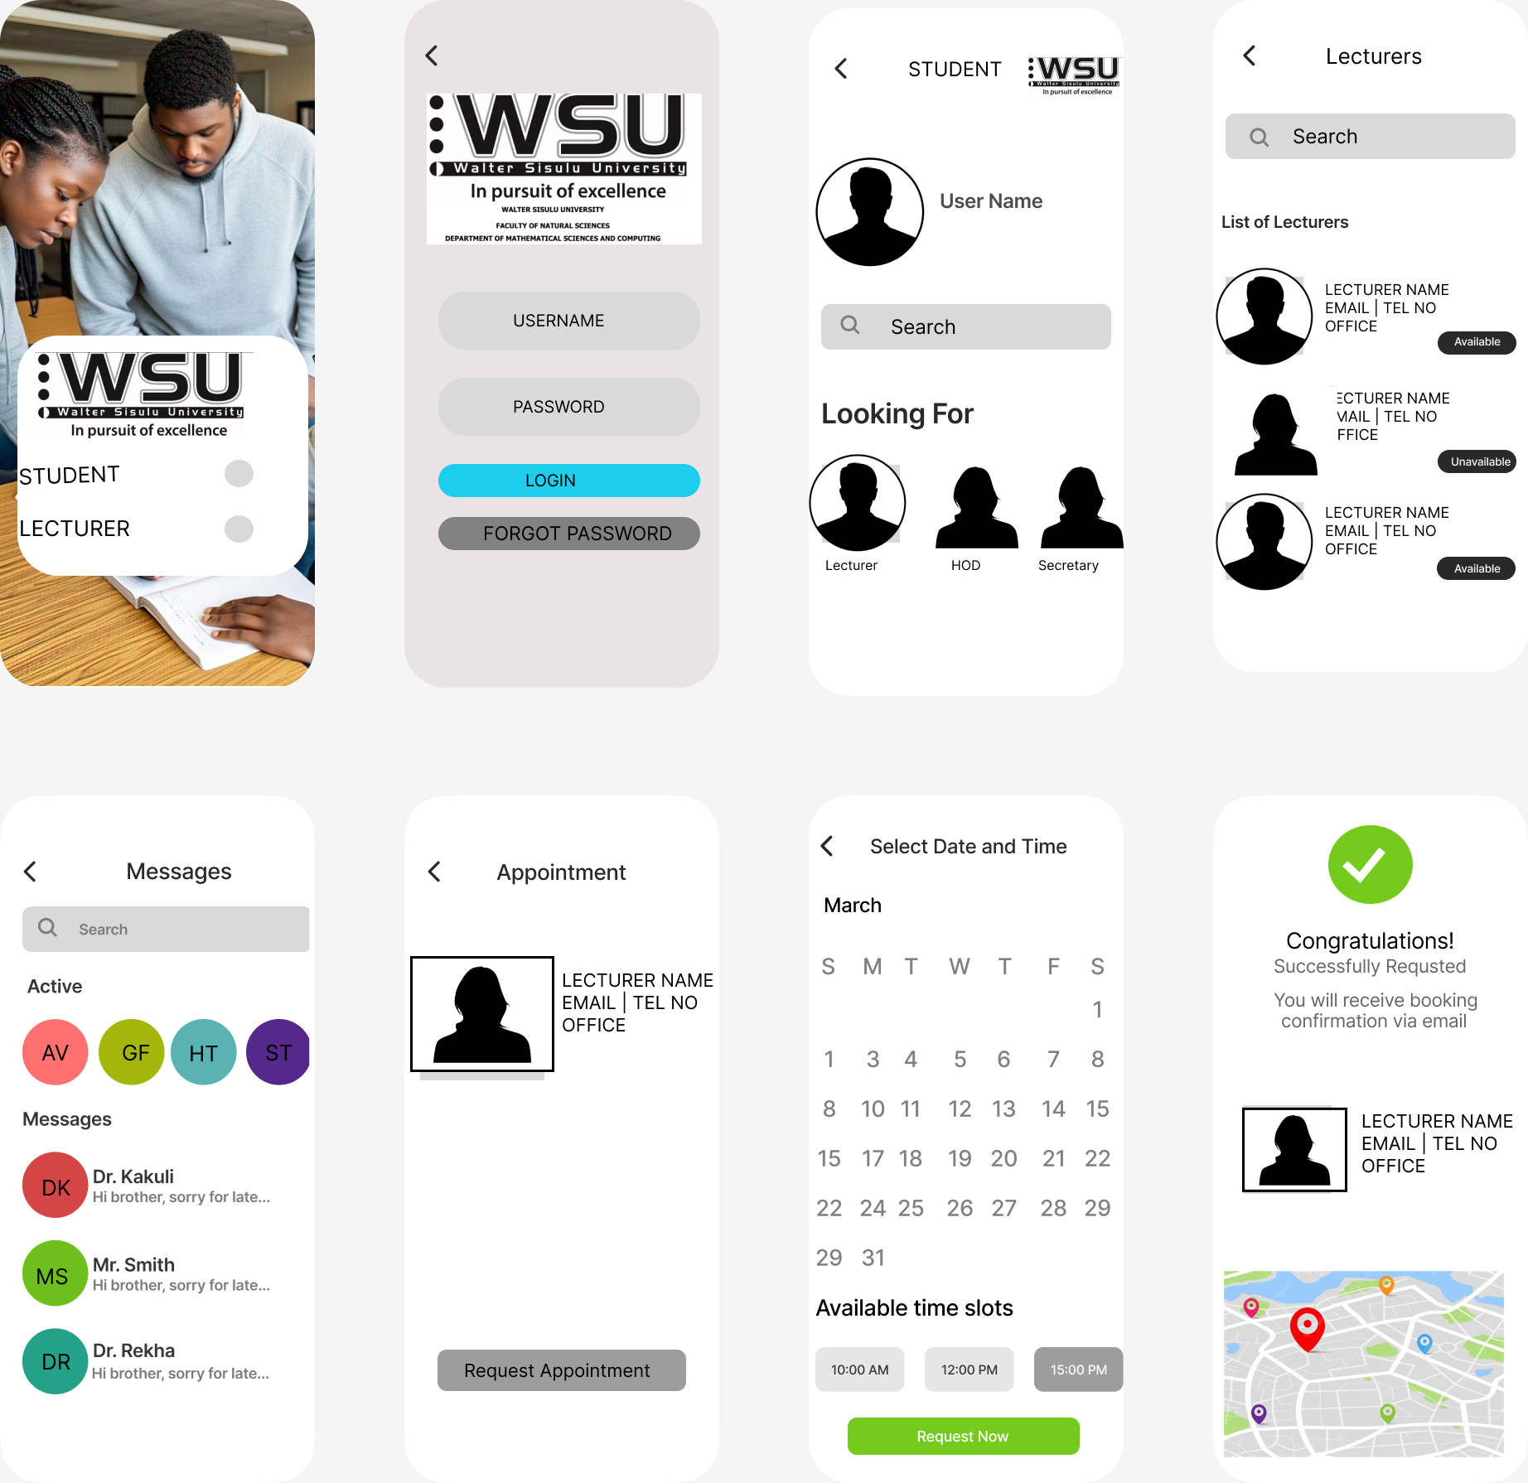
Prototypes
Lecturer Prototype
Student Prototype

Slide 12

Project Timeline
Phase 1: Software Product Vision & Prototyping (Weeks 1-3)
Phase 2: Agile Development Planning (Weeks 4-6)
Phase 3: Features, Scenarios, and User Stories (Weeks 7-9)
Phase 4: Software Architecture & System Design (Weeks 10-12)

